Slide 1

DEEP LEARNING-BASED LEAF DISEASE DETECTION AND CLASSIFICATION USING YOLO
Team Details:
Names:AISHWARYA GK / 211423104016
AVANTHICA V/211423104073
Batch Number:A11 Domain: AI DEEP LEARNING
Guide Name & Designation Coordinator Name & Designation
Date:29-10-2025

Slide 2



SDGs and TARGETs
1.Primary Goal No: 2 – Zero Hunger
Target 1: End hunger and provide safe, nutritious food for all by 2030.
Target 2: End malnutrition and meet the nutritional needs of women, children,
and elderly by 2030.
Target 3: Double small farmers’ productivity and income with better knowledge
and technology by 2030.
2.Secondary Goal No: 9 – Industry, Innovation and Infrastructure
Target 1: Build reliable and sustainable infrastructure for economic growth.
Target 2: Promote sustainable industries and increase jobs and GDP.
Target 3: Boost research and innovation in industrial sectors.
3.Tertiary Goal No: 12 – Responsible Consumption and Production
Target 1: Follow sustainable consumption and production programs.
Target 2: Use natural resources efficiently by 2030.
Target 3: Cut global food waste and reduce supply chain losses by 2030.

Slide 3
Base paper Details
Title:Plant Disease Detection and Segmentation using End-to-End YOLOv8: A Comprehensive Approach.
Authors:Syed Asif Ahmad Qadri – National Tsing Hua University, TaiwanShowkat Ahmad Bhat – National Tsing Hua University, TaiwanNen-Fu Huang – National Tsing Hua University, TaiwanTaiba Majid Wani – Sapienza University of Rome, Italy
Journal/Conference2023: IEEE 13th International Conference on Control System, Computing and Engineering (ICCSCE)Location: Penang, MalaysiaDates: 25–26 August 2023
Year:2023
Publisher:IEEE (Institute of Electrical and Electronics Engineers)DOI: 10.1109/ICCSCE58721.2023.10237169

Slide 4
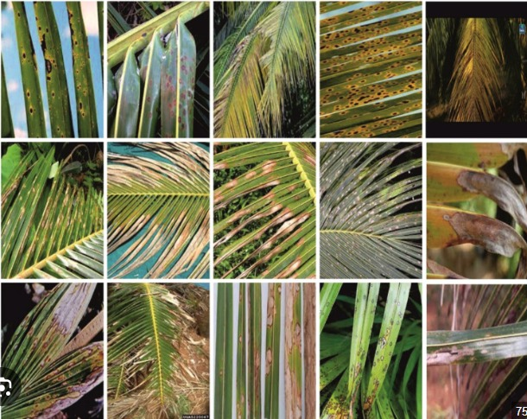
Problem Statement
In agriculture, early and accurate identification of plant leaf diseases is crucial to prevent
crop losses, reduce the misuse of chemical treatments, and improve overall yield. Traditional
methods of disease detection are largely manual, time-consuming, prone to human error, and
often unavailable to small-scale farmers due to lack of access to experts or resources.
With the increasing availability of smartphone cameras and low-cost computing devices,
there is a need for an automated, real-time, and cost-effective system that can detect and classify
leaf diseases from images accurately.
This project aims to design and implement a deep learning-based solution using the YOLO
(You Only Look Once) object detection algorithm to automatically detect and classify various plant leaf diseases in real-time.
The system will use annotated images of diseased and healthy leaves to train the YOLO model, enabling fast and accurate disease identification.
The goal is to assist farmers in taking timely and appropriate actions, thereby enhancing productivity and supporting sustainable agricultural practices.

Slide 5
Abstract
Coconut cultivation plays a vital role in tropical agriculture and the economy, but its productivity is often threatened by various leaf diseases that hinder plant growth and yield. Early and accurate detection of these diseases is essential to support timely intervention and sustainable crop management. This work presents an advanced framework for coconut leaf disease classification using deep learning.
The proposed system leverages the YOLOv11 architecture. To ensure accessibility and practical deployment, the model is integrated into a Django-based web application, providing an intuitive interface for real-time image upload, detection, and disease diagnosis.
Experimental results demonstrate that the system achieves reliable classification performance, offering farmers and agricultural experts a practical decision-support tool.
By combining cutting-edge deep learning techniques with a user-friendly web interface, this study contributes to precision agriculture and promotes healthier coconut crop management through timely disease identification.
Coconut Leaf Disease,YOLOv11, Deep Learning, Image Classification, Django Framework, Precision Agriculture.

Slide 6
Objectives and Significance
🌱 Objectives
The main objectives of this project are to design and implement a robust coconut leaf disease detection system that leverages the advanced YOLOv11 architecture for accurate and real-time identification of diseased regions, to develop a scalable and interactive Django-based web platform that allows users to easily upload images and obtain instant diagnostic results, to enhance agricultural decision-making by providing early detection and reducing dependency on manual expert analysis, to ensure the system is accessible and farmer-friendly for practical deployment in real-world agricultural environments, and to contribute to sustainable farming practices by minimizing crop losses and improving overall productivity through timely intervention.
🌱 Significance of the Project
Promotes early diagnosis and treatment of coconut leaf diseases, improving crop health and yield.
Minimizes reliance on manual inspection, reducing human error and increasing efficiency in large-scale plantations.
YOLO enables real-time detection, making the system suitable for in-field applications using mobile or drone imagery.
Supports sustainable agriculture by enabling precision farming practices and timely disease control.
Bridges the technology gap for smallholder farmers, offering a cost-effective, AI-driven solution.
Contributes to food and economic security, as coconut is a key crop in tropical regions like India, Sri Lanka, and the Philippines.Serves as a model framework that can be extended to other crops and diseases in future agricultural AI systems.

Slide 7
Social Relevance
Social Relevance Benefit to Society:
This project helps farmers detect coconut leaf diseases early, improving crop yield, reducing losses, and promoting sustainable farming with minimal pesticide use.
Link to UN SDGs:
SDG 2: Zero Hunger – Supports food security by protecting crops.
SDG 12: Responsible Consumption – Reduces chemical overuse.
SDG 9: Industry & Innovation – Applies AI in agriculture.
Real-World Impact:
It solves the problem of delayed or inaccurate disease detection, especially for small farmers lacking expert access, using fast, reliable YOLO-based AI technology.

Slide 8
Research and Literature Review
1. YOLO for Detecting Plant Diseases
Aspect | Details
Author | Chairma Lakshmi K. R., Shalini S., Gautham V., et al.
Summary | This paper applies YOLOv3 for real-time detection of multiple plant diseases using leaf images. The system is designed for agricultural applications where rapid detection is required to prevent yield loss.
Relevance | Demonstrates feasibility of using YOLO for agricultural disease detection. Forms a strong base for your coconut leaf disease detection project.
Gaps | Limited to YOLOv3 (older version) with lower accuracy compared to YOLOv5/YOLOv8. Dataset was generic, not crop-specific.
Impact | Introduced real-time detection for farmers. Helped reduce dependency on manual inspection.

Slide 9
Research and Literature Review
2.SPQ: Similarity-Preserving Posttraining Quantization
Aspect | Details
Author | Carlos V. Padeiro et al.
Summary | Proposes a lightweight model for crop disease detection using SPQ to preserve accuracy in quantized CNNs.
Relevance | Ideal for mobile use in rural areas with limited internet.
Gaps | Lacks classification variety and explainability.
Impact | Enables efficient, portable disease detection with minimal performance loss.

Slide 10
Research and Literature Review
3. Improving Plant Disease Classification with XAI
Aspect | Details
Author | Natasha Nigar et al.
Summary | Uses EfficientNetB0 and LIME to classify 38 diseases with 99.69% accuracy and provide visual explanations.
Relevance | Combines high accuracy with interpretability.
Gaps | No edge-device support or real-time detection.
Impact | Builds trust in AI through transparency and aids farmers in decision-making.

Slide 11
Research and Literature Review
4. Plant Leaf Disease Detection with Ensemble Learning & XAI
Aspect | Details
Author | Ammar Oad et al
Summary | Combines VGG16, VGG19, ResNet101V2, and InceptionV3 with LIME for better accuracy and interpretability.
Relevance | Robust system for detecting 38 diseases across multiple crops.
Gaps | Lacks real-time detection and mobile deployment.
Impact | Improves accuracy and reliability through model fusion and explanation.

Slide 12
Research and Literature Review
5. Comparative Analysis with ML and DL Methods
Aspect | Details
Authors | Varun Tiwari et al.
Summary | Compares ML and DL (like SVM, CNN) for plant disease detection and highlights CNN superiority.
Relevance | Guides model selection based on data and task.
Gaps | No deployment, no XAI, and limited practical use case.
Impact | Provides a strong theoretical foundation for selecting detection techniques.

Slide 13
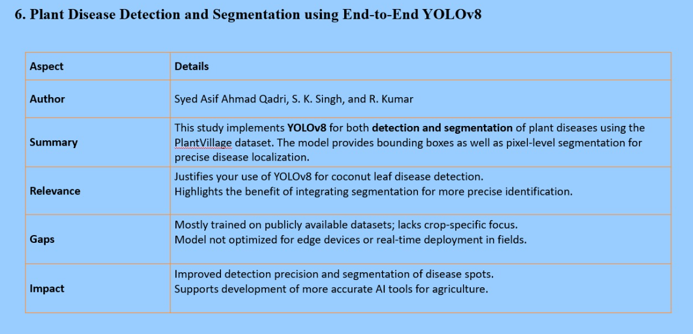
Research and Literature Review

Slide 14
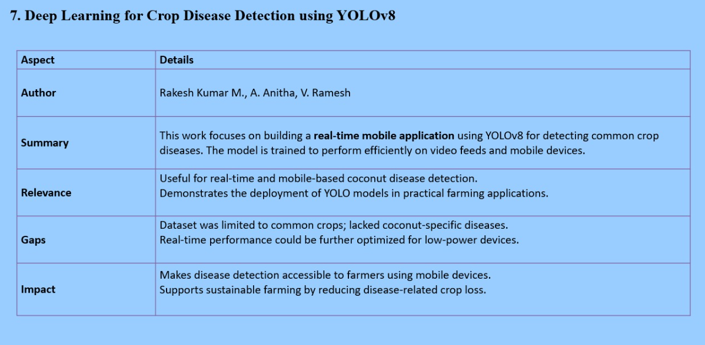
Research and Literature Review

Slide 15
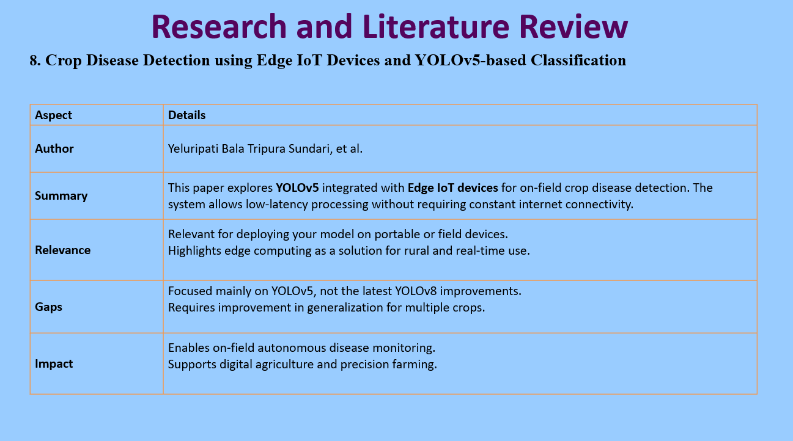

Slide 16
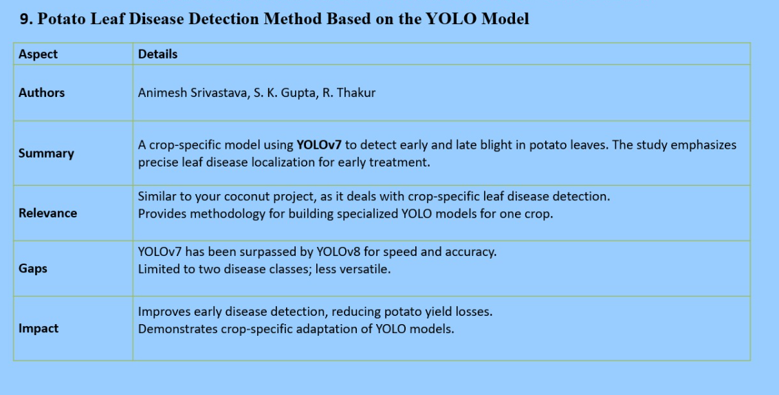
Research and Literature Review

Slide 17
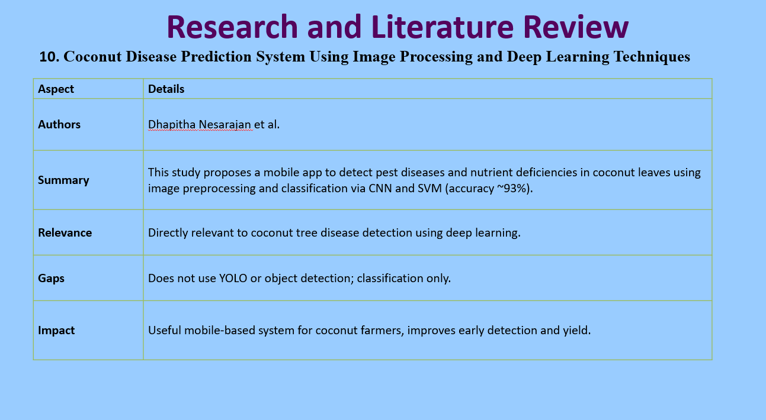

Slide 18
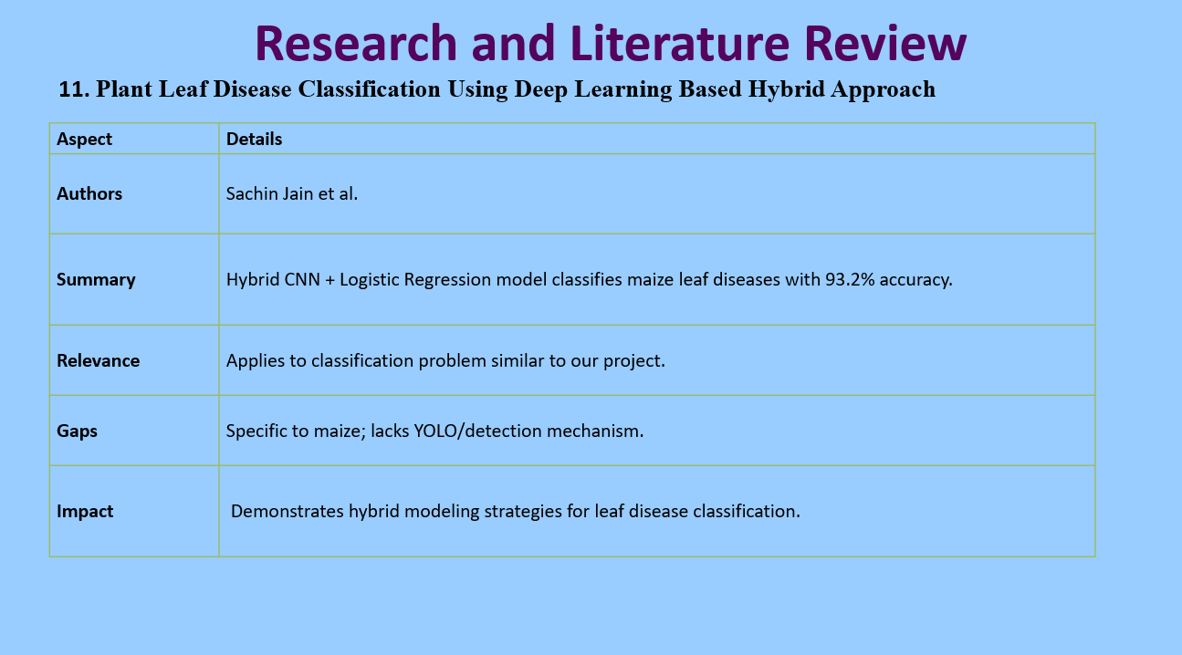

Slide 19
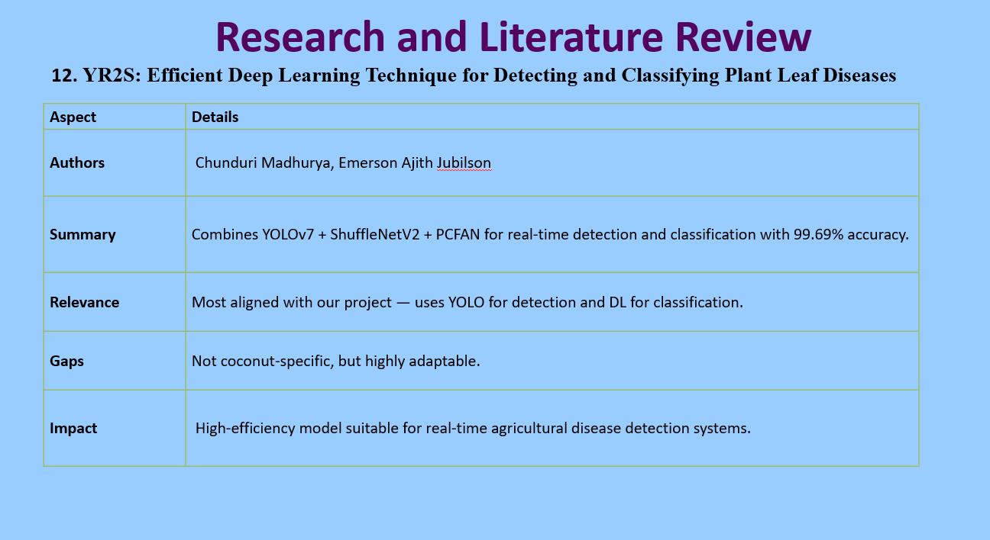

Slide 20
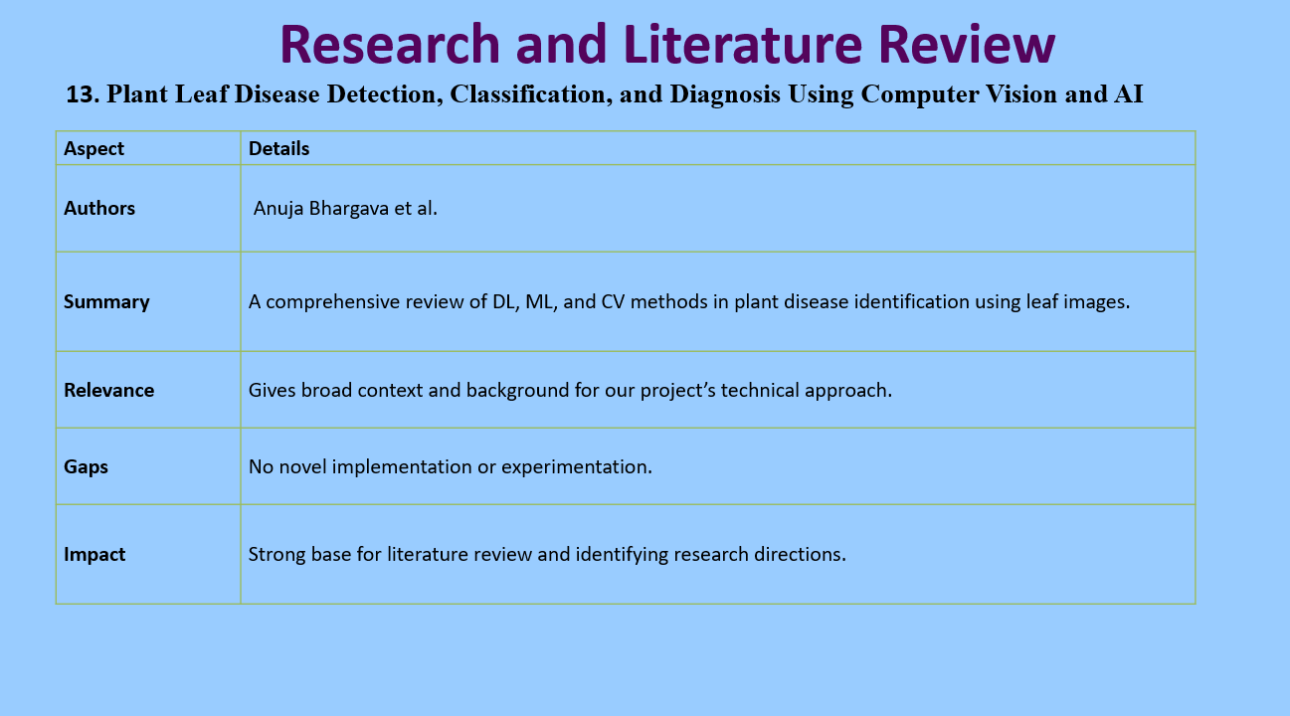

Slide 21
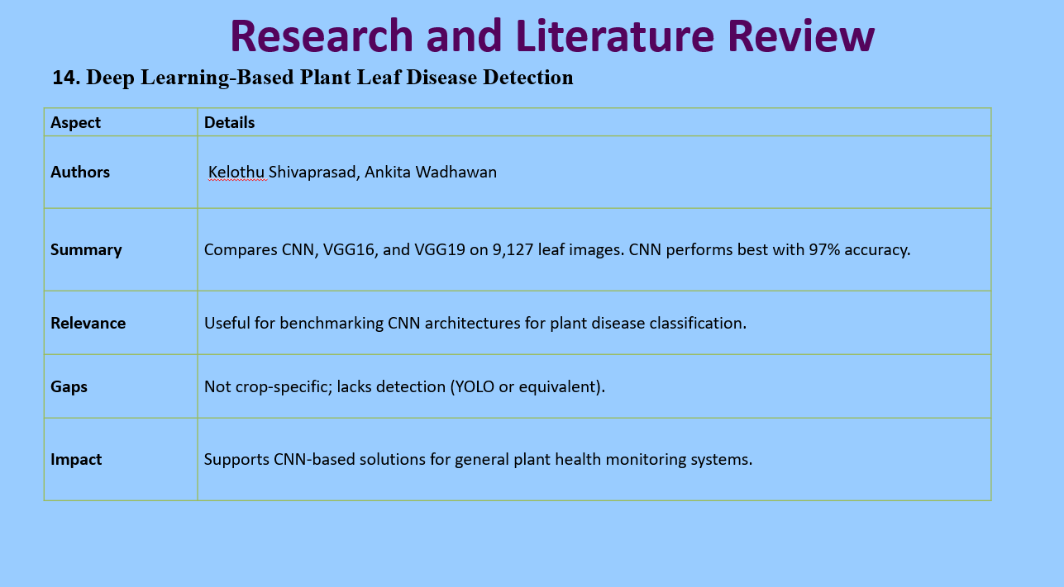

Slide 22
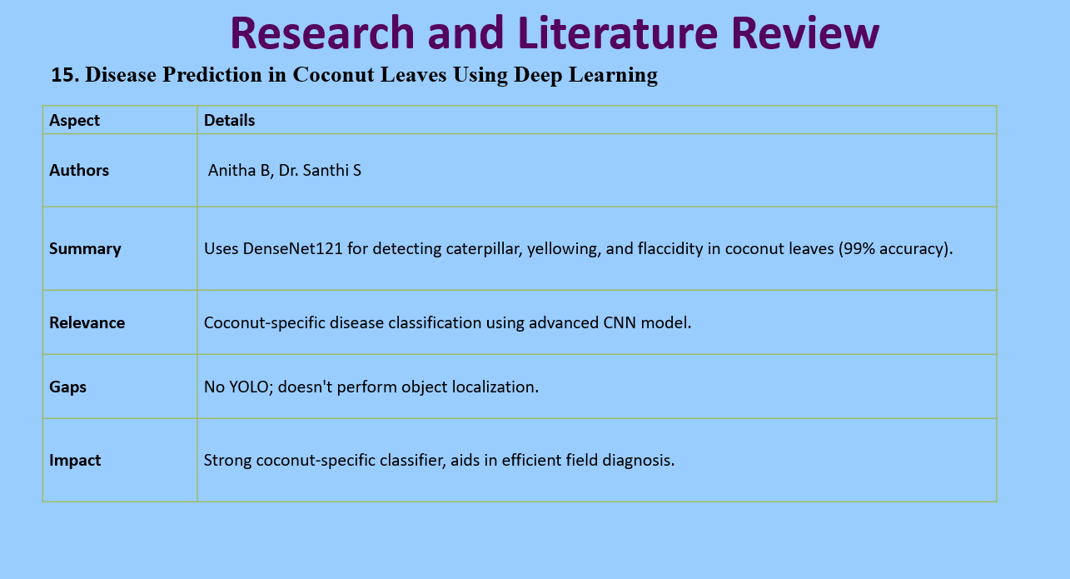

Slide 23
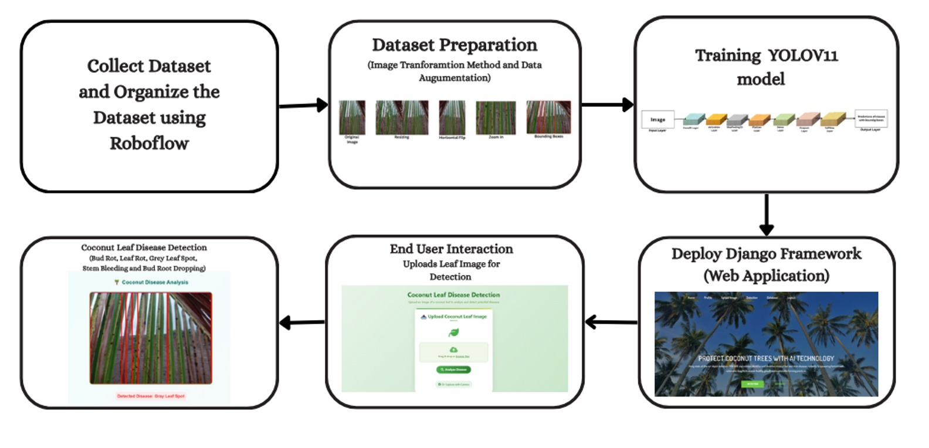
Proposed System-Architecture Diagram

Slide 24
Step 1: Input and Data Preparation
The Coconut Tree Disease Dataset contains 5,798 labeled images of coconut leaves affected by five major diseases — bud rot, leaf rot, gray leaf spot, stem bleeding, and bud root dropping. The images were captured under daylight conditions in the Kendur area of Pune, Maharashtra, ensuring realistic field variations. Preprocessing involved scaling, cropping, and contrast enhancement to standardize image quality. Using Roboflow, the images were annotated and resized to uniform dimensions suitable for neural network processing. To increase dataset diversity and reduce overfitting, data augmentation techniques such as normalization, shearing, zooming, and horizontal flipping were applied. This process ensures the model can recognize disease patterns across various lighting conditions, angles, and environmental settings.
Step 2: Training the YOLOv11 Model
The preprocessed dataset is used to train the YOLOv11 (You Only Look Once) deep learning model. The model employs convolutional and pooling layers to extract spatial features like leaf textures and disease spots, followed by dense layers that classify the detected patterns into specific disease categories. Activation functions help capture nonlinear relationships, while dropout layers prevent overfitting. The model undergoes multiple epochs during training, continuously adjusting its parameters to minimize error and improve accuracy in detecting and classifying coconut leaf diseases.
Step 3: Model Deployment
Once trained, the YOLOv11 model is integrated into a Django-based web application. The Python backend manages

Slide 25
model execution, handles image uploads, and stores outputs in an SQLite3 database, while the frontend, built using HTML, CSS, and JavaScript, provides an intuitive user interface. A language model is incorporated to extend the system’s capability — not only identifying the disease but also offering treatment recommendations to help farmers address the problem effectively.
Step 4: End-User Interaction
Farmers or agricultural workers can log in to the web platform and upload images of coconut leaves. The model processes the image, highlights infected areas using bounding boxes, and displays the predicted disease name with a confidence score. Alongside the prediction, the system provides treatment guidance, making it practical for real-world use. All user data, predictions, and images are stored securely, allowing users to review previous results when needed.
Step 5: Feedback and Continuous Improvement
To maintain long-term reliability, the system includes a feedback mechanism. Images that are misclassified or show low prediction confidence are flagged for review. After verification, these images are added back to the training set, allowing the model to be retrained periodically. This continuous learning process helps the system adapt to new disease variations and environmental changes, improving its precision and robustness over time.

Slide 26
Hardware and software specifications
Hardware Requirements:
Minimum Requirements (for development & small-scale testing)
Processor: Intel Core i5 (8th Gen or higher) / AMD Ryzen 5
RAM: 8 GB
Storage: 256 GB SSD
GPU: NVIDIA GTX 1050Ti / RTX 1650 (4 GB VRAM) or higher
Camera/Smartphone: For capturing coconut leaf images
Internet: Stable connection for model updates & LLM module
Recommended Requirements (for training & better inference)
Processor: Intel Core i7/i9 or AMD Ryzen 7/9
RAM: 16–32 GB
Storage: 512 GB – 1 TB SSD (for dataset + model checkpoints)
GPU: NVIDIA RTX 3060/3070/3080 or A100 (8–24 GB VRAM)
High-Resolution Camera/Drone: For field image collection (optional for real-time farming use)

Slide 27
Software requirements:
OS: Windows 10/11 or Ubuntu 20.04/22.04 LTS
Dev Environment: Python 3.9+, Jupyter Notebook / Google Colab / VS Code
Libraries/Frameworks:Deep Learning: YOLOv11, PyTorch 2.0+, OpenCV
Data: NumPy, Pandas, Matplotlib, Seaborn, scikit-learn
Web: Django 4.x, SQLite3/PostgreSQL, HTML/CSS/JS, Bootstrap/Tailwind
LLM: Hugging Face Transformers / OpenAI API / LLaMA
Other Tools: LabelImg/Roboflow (annotation), Docker (optional), Git/GitHub, VS Code/PyCharm

Slide 28
Module Description / Component Specifications
IMPLEMENTATION OF YOLOV11
YOLOv11 is an advanced real-time object detection model by Ultralytics, offering improved accuracy, speed, and feature extraction through modules like C3K2 and C2PSA. It supports tasks such as detection, classification, and segmentation, making it ideal for agricultural applications like coconut disease detection.
Dataset Preparation: Images are preprocessed using Keras ImageDataGenerator — resized, normalized, and augmented (rotation, zoom, flip) — and split into training, validation, and test sets.
Model Training: The model is compiled with an optimizer (e.g., Adam), suitable loss function, and metrics, then trained using the fit() function with validation to avoid overfitting.
YOLOv11 Architecture:
Input Layer: Accepts image tensors.
Convolution Layers: Extract spatial features.
Pooling Layers: Reduce dimensionality.
Fully Connected Layers: Interpret features for classification.
Softmax/Logistic Layer: Output multi-class probabilities.
Output Layer: Predicts disease class (e.g., Bud Rot, Leaf Rot).
Prediction: Preprocessed images are passed through the trained model using predict(), which classifies coconut leaves into their respective disease categories in real time.

Slide 29
DEPLOYMENT
Django, a high-level Python web framework following the Model–Template–View (MTV) architecture, is used to deploy the trained YOLOv11 model for coconut leaf disease detection. It enables real-time interaction through a simple web interface.
Model Conversion: The trained YOLOv11 model is saved as an .h5 file, storing its architecture and weights for easy reuse.
Integration with Django: The model is loaded in Django, where a dedicated app manages image uploads, preprocessing, and prediction through defined routes and views.
Image Upload & Preprocessing: Uploaded images are resized, normalized, and converted into arrays suitable for model input.
Prediction Process: The preprocessed image is passed to YOLOv11, which predicts the disease label (e.g., Bud Rot, Leaf Rot, or Healthy).
Result Display: The predicted result is displayed on the web page, allowing users to view or upload new images.
Advantages:
Simple, user-friendly interface
Scalable and secure
Easily integrates with databases, APIs, and cloud services
Reusable across web, mobile, and IoT platforms

Slide 30
Justification for POSITIVE
Enhanced Productivity and Crop Health:Early and accurate detection of coconut leaf diseases allows farmers to intervene promptly, reducing the spread of infections. This helps maintain higher crop yields and healthier plants, directly benefiting both the agricultural economy and food security.
Application of Advanced Technology:By leveraging the YOLOv11 deep learning architecture, the system achieves high accuracy and real-time performance. This ensures that disease detection is both reliable and efficient, which is critical for practical agricultural use.
Accessibility through User-Friendly Interface:Integration into a Django-based web application makes the system accessible to farmers and agricultural experts without requiring specialized technical knowledge. Users can upload leaf images and receive instant diagnoses, making sophisticated AI technology practical and usable in real-world scenarios.
Support for Precision Agriculture:The framework aligns with precision agriculture principles, where data-driven decisions optimize crop management. Timely disease identification reduces unnecessary pesticide usage, promotes sustainable practices, and minimizes economic losses.
Decision-Support Tool for Stakeholders:By providing accurate and real-time insights, the system empowers farmers, agronomists, and agricultural policymakers to make informed decisions. This improves resource allocation, enhances crop monitoring, and supports long-term agricultural planning.
Contribution to Research and Development:The project demonstrates the successful application of state-of-the-art AI models in agriculture, serving as a reference for future studies in plant disease detection and precision farming technologies.

Slide 31
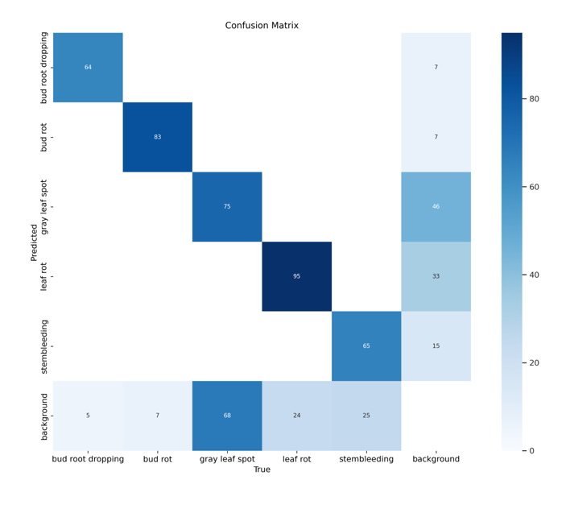
Experimental Results
CONFUSION MATRIX FOR YOLOv11

Slide 32
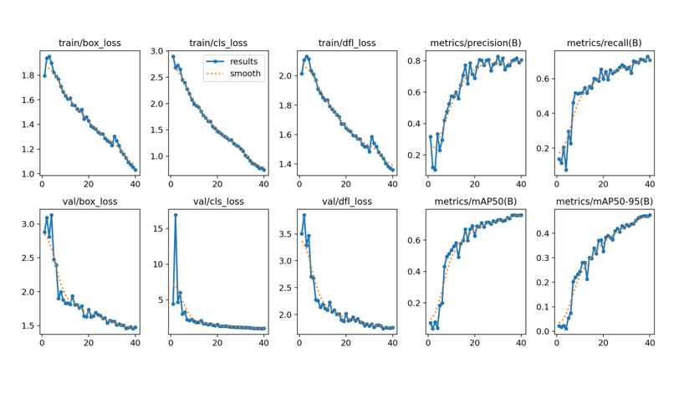
Experimental Results
VISUAL ANALYSIS OF YOLOv11

Slide 33
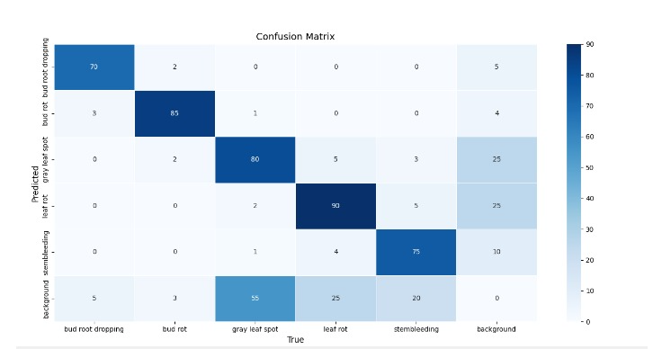
Experimental Results
CONFUSION FOR YOLOv8

Slide 34
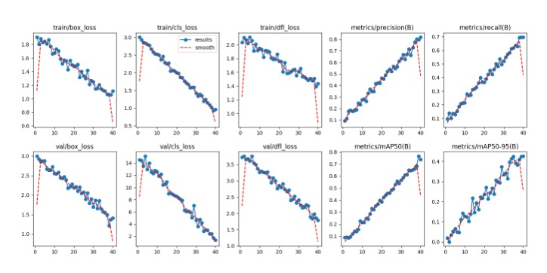
Experimental Results
VISUAL ANALYSIS OF YOLOv8

Slide 35
Experimental Results
A comparative analysis between YOLOv11 and YOLOv8 was conducted using the same coconut leaf disease dataset with five classes under identical conditions (640×640 resolution, batch size 16, learning rate 0.001, 40 epochs). YOLOv11 achieved faster convergence and higher accuracy (precision 0.93, recall 0.91, mAP@50 = 0.90) compared to YOLOv8 (precision 0.85, recall 0.83, mAP@50 = 0.84), while also reducing inference latency by about 18%.
The confusion matrix showed that YOLOv11 reduced misclassifications—especially between Grey Leaf Spot and Leaf Rot—by nearly 40% and produced sharper, more confident detections. These improvements are due to its enhanced backbone, anchor-free detection head, improved PAN, and optimized DFL, enabling better feature extraction and localization. Overall, YOLOv11 demonstrated superior accuracy, stability, and speed, making it the optimal model for real-time coconut leaf disease detection in the Django-based web framework.

Slide 36
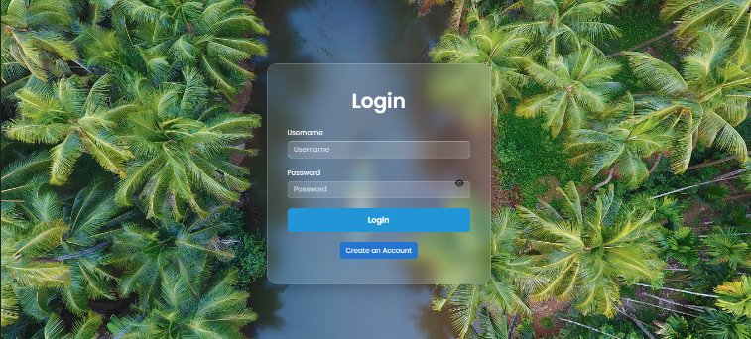
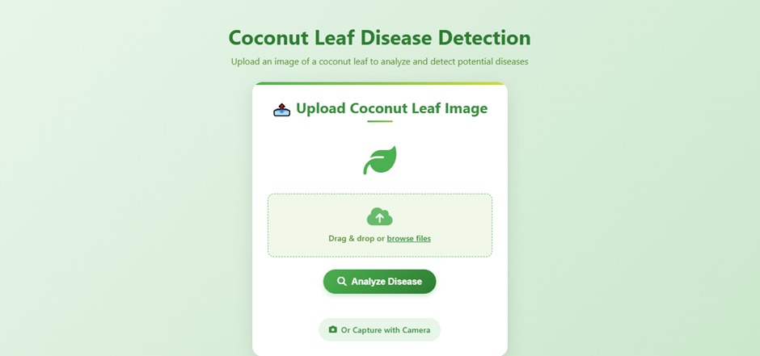
Experimental Results

Slide 37
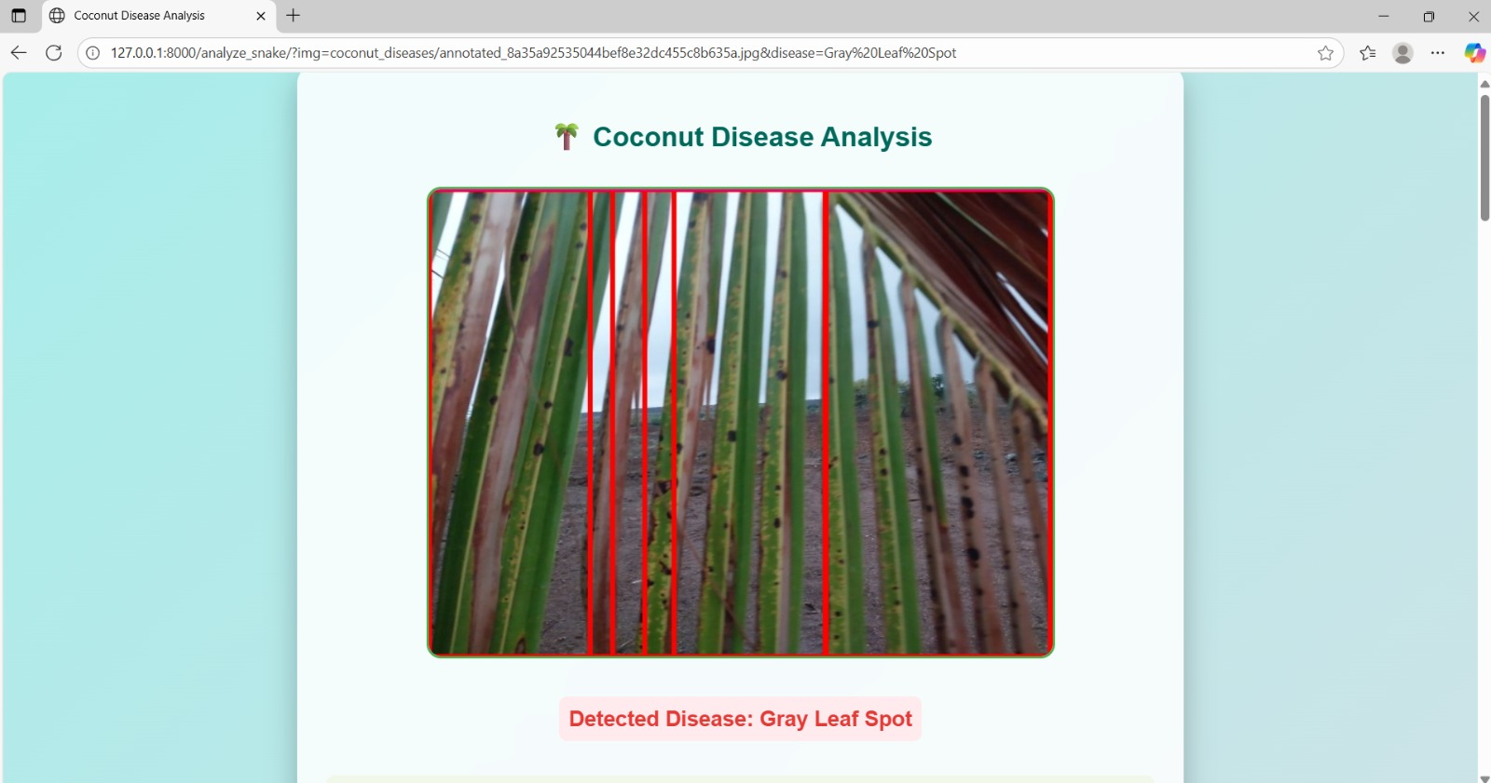
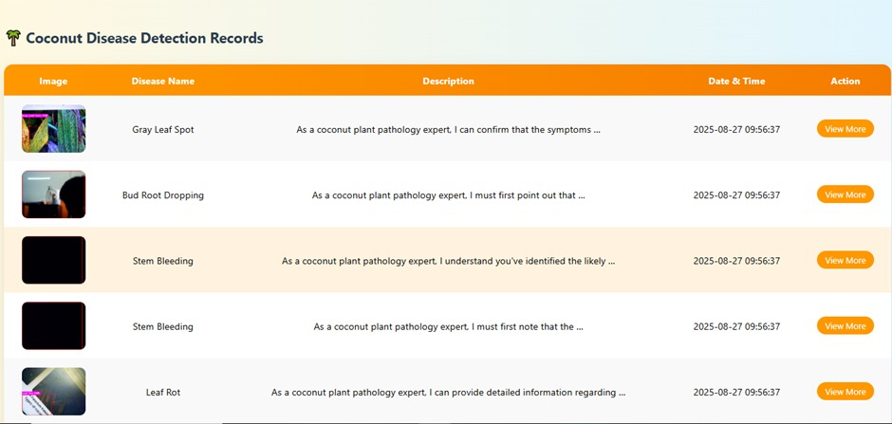
Experimental Results

Slide 38
Project Showcase and Future Steps
Project Showcase
System Features: Real-time coconut leaf disease detection, image-based classification, and instant disease diagnosis.
Demonstration: Live web application prototype showcasing image upload, YOLOv11-based detection, and disease identification results.
Technological Highlights: Deep learning (YOLOv11), Django web framework, and intuitive user interface for real-time interaction.
Use Cases: Support for farmers, agricultural experts, and plantation managers in timely disease intervention and precision agriculture.
Future Steps
Enhancements: Integrate more crop disease types and multilingual support for wider accessibility.
Scalability: Optimize the system for large-scale deployment across multiple plantations with batch image processing.
Collaboration: Partner with agricultural research institutions and farmer cooperatives for data sharing and system improvement.

Slide 39
Conclusion
The proposed system demonstrates the potential of deep learning-based approaches to transform agricultural disease management through real-time coconut leaf disease detection. By leveraging the advanced YOLOv11 architecture, the model delivers highly accurate and efficient identification of multiple coconut leaf diseases, including Bud Rot, Leaf Rot, Grey Leaf Spot, Stem Bleeding, and Bud Root Dropping. This automation significantly reduces the dependency on manual inspection methods, which are often time-consuming, labour-intensive, and prone to human error.
The integration of the trained YOLOv11 model into a Django-based web application enables users—particularly farmers and agricultural experts—to easily upload images of coconut leaves and receive instant diagnostic results. This real-time capability ensures timely detection and intervention, which is crucial for preventing the spread of infections and minimizing crop losses. The system’s user-friendly interface, coupled with its robust detection performance, makes it accessible even to users with minimal technical expertise.
Moreover, the proposed framework supports sustainable agricultural practices by enhancing crop monitoring efficiency, improving yield quality, and optimizing resource utilization. By enabling early diagnosis and precise identification of disease symptoms, it assists in implementing targeted treatment measures, thereby reducing unnecessary pesticide usage and promoting environmental safety.
Overall, this project highlights how integrating deep learning models like YOLOv11 into practical web-based platforms can revolutionize smart farming systems. It serves as a scalable and cost-effective solution for precision agriculture, empowering the agricultural community to make data-driven decisions, ensure healthier crops, and contribute toward long-term food security.

Slide 40
References
[Yolo for Detecting Plant Diseases]
Authors: Chairma Lakshmi K R, Nithya Jenev J, Praveena B, et al.Conference: 3rd International Conference on Artificial Intelligence and Smart Energy (ICAIS 2023)
IEEE DOI: 10.1109/ICAIS56108.2023.10073875
[SPQ: Similarity-Preserving Posttraining Quantization for Portable Crop Disease Detection]
Authors: Carlos Victorino Padeiro, Tse-Wei Chen, Takahiro Komamizu, Ichiro IdeJournal: IEEE Transactions on Agrifood Electronics
IEEE DOI: 10.1109/TAFE.2025.3533416
[Plant Leaf Disease Detection Using Ensemble Learning and Explainable AI]
Authors: Ammar Oad, Syed Shoaib Abbas, Amna Zafar, et al.Journal: IEEE Access
IEEE DOI: 10.1109/ACCESS.2024.3484574
[Improving Plant Disease Classification With Deep-Learning-Based Prediction Model Using Explainable AI]
Authors: Natasha Nigar, Hafiz Muhammad Faisal, Muhammad Umer, et al.Journal: IEEE Access
IEEE DOI: 10.1109/ACCESS.2024.3428553
[Plant-Leaf Disease Detection: A Comparative Analysis With Machine Learning and Deep Learning Methods]
Authors: Varun Tiwari, Amit Kumar Bairwa, Shashi Bhushan SharmaConference: 2024 IEEE International Conference on Modeling, Simulation & Intelligent Computing (MoSICom)
IEEE DOI: 10.1109/MoSICom63082.2024.10881929
[Plant Disease Detection and Segmentation using End-to-End YOLOv8: A Comprehensive Approach]
Authors: Syed Asif Ahmad Qadri, Showkat Ahmad Bhat, Nen-Fu Huang, Taiba Majid WaniConference: 2023 IEEE 13th International Conference on Control System, Computing and Engineering (ICCSCE)
IEEE DOI: 10.1109/ICCSCE58721.2023.10237169

Slide 41
Thank You

